Slide 1
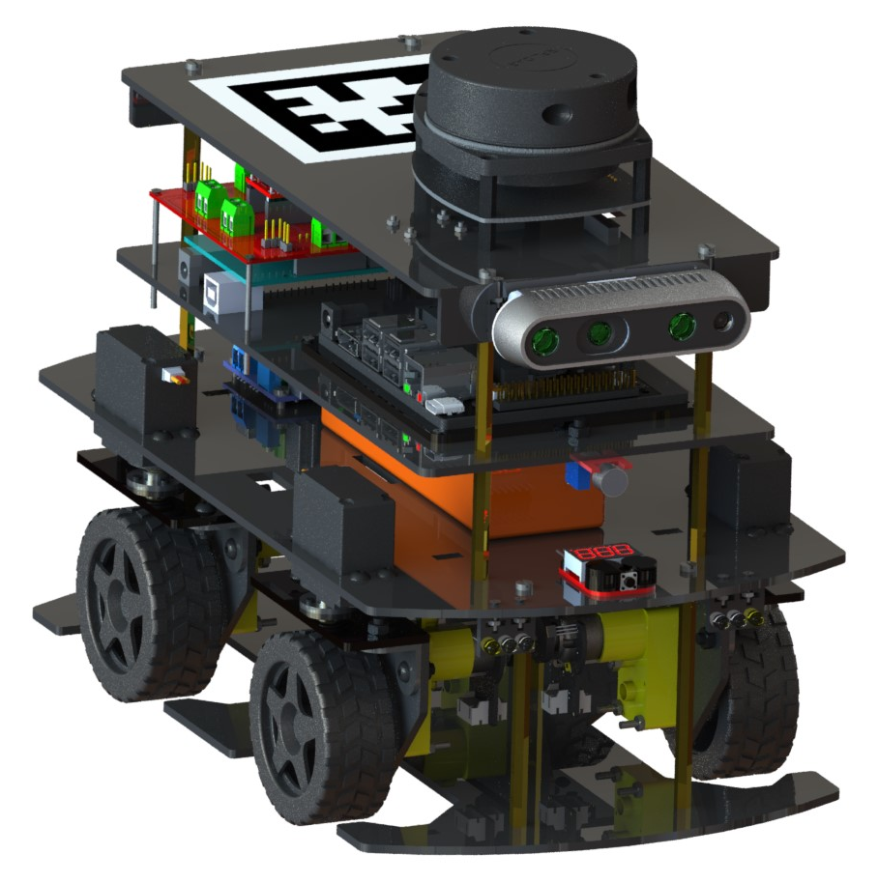

Slide 2
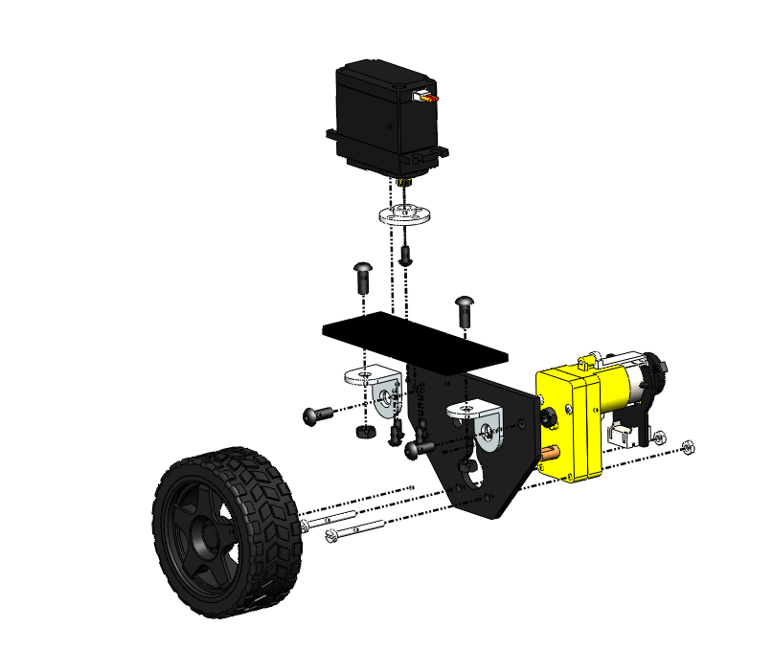
4
1
5
3
2

Slide 3
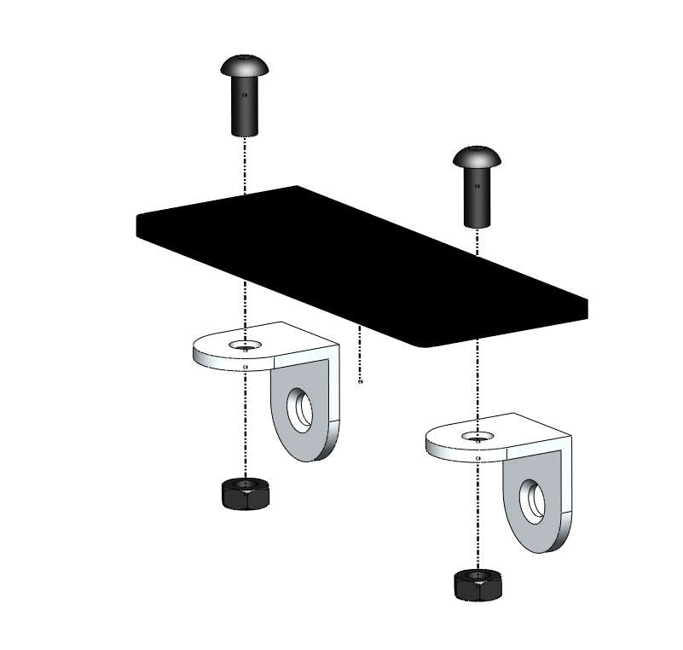
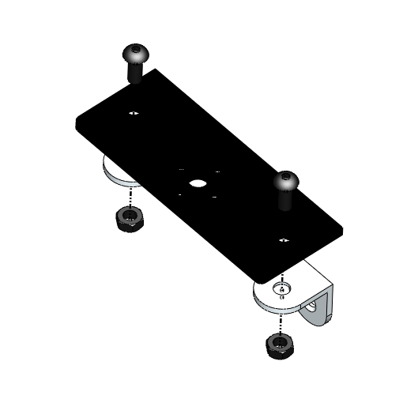
TOP VIEW
M4 x 10 BOLT
M4 NUT

Slide 4
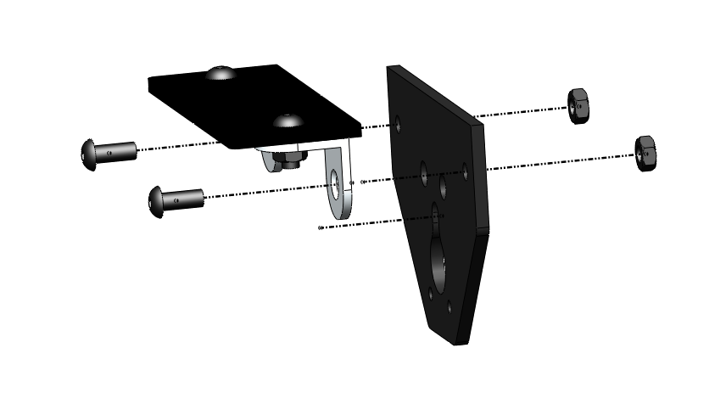
M4 x 10 BOLT
M4 NUT

Slide 5
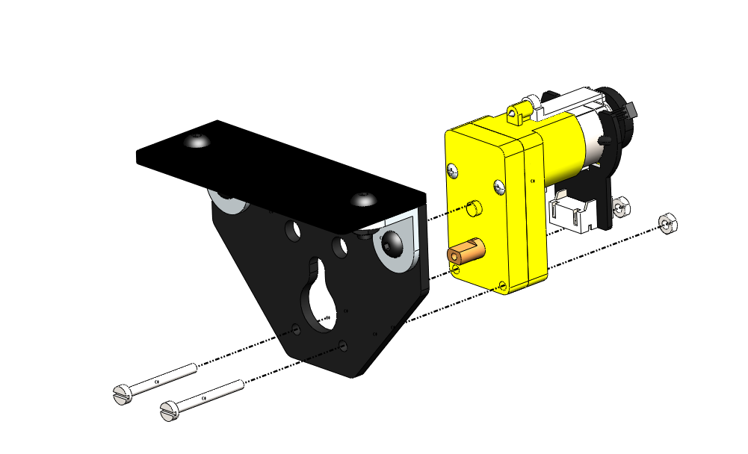
M2.5 x 25 BOLT
M2.5 NUT

Slide 6
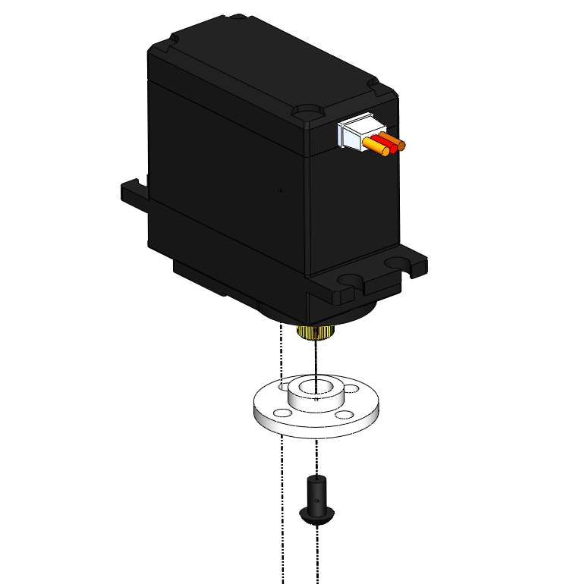
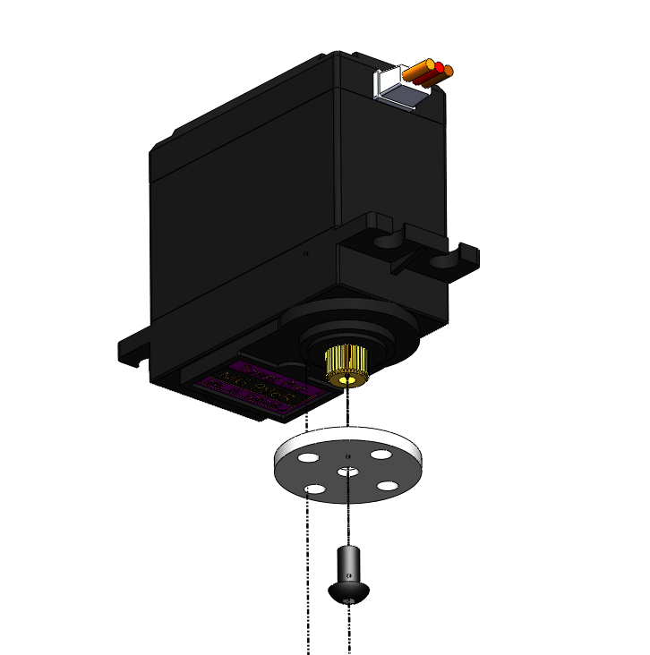
M3 x 6 BOLT
BOTTOM VIEW

Slide 7
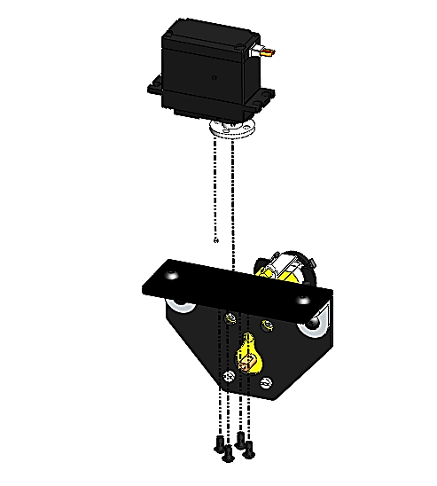
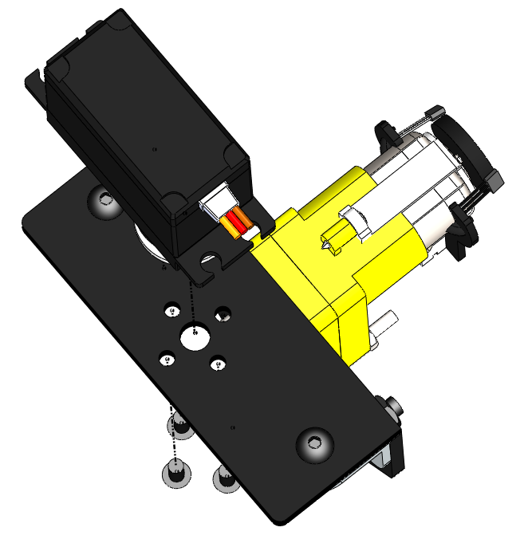
TOP VIEW
M3 x 6 BOLT

Slide 8
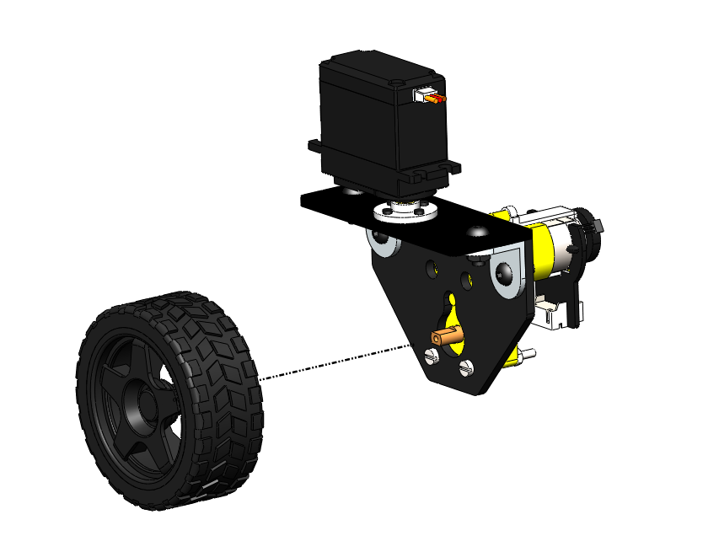
WHEEL PRESS FIT INTO THE MOTOR SHAFT

Slide 9
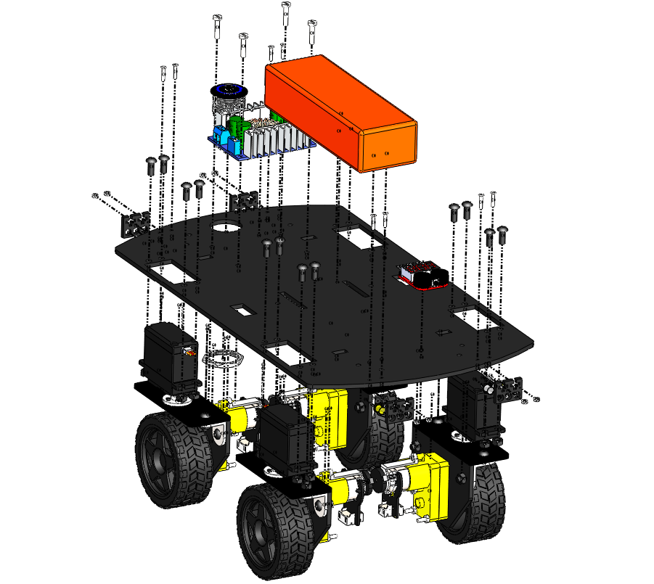
2
4
3
6
5
7
1

Slide 10
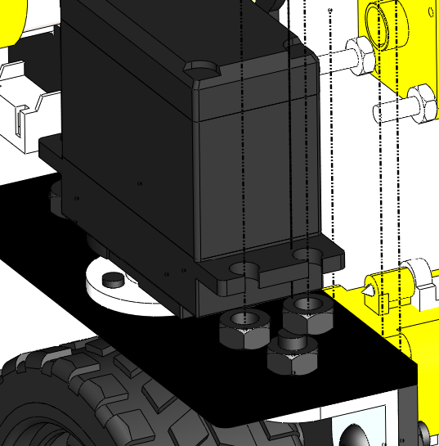
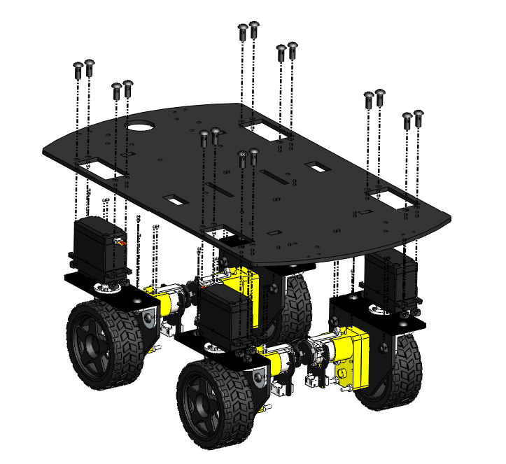
M4 X 10 BOLT
M4 NUT
THIS FACE IS PLACED FLUSH AGAINST THE PLATFORM

Slide 11
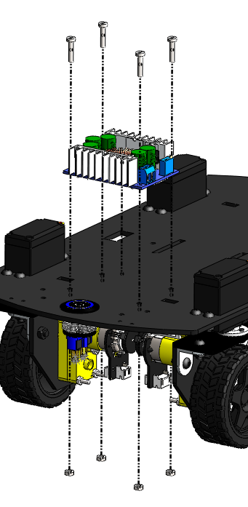
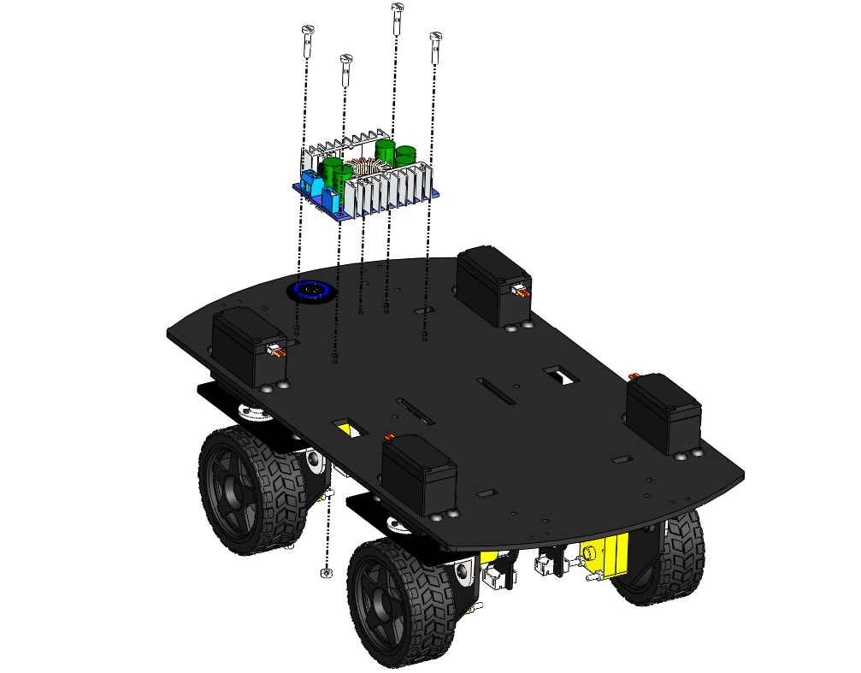
M3 X 14 BOLT
REAR VIEW
M3 NUT

Slide 12
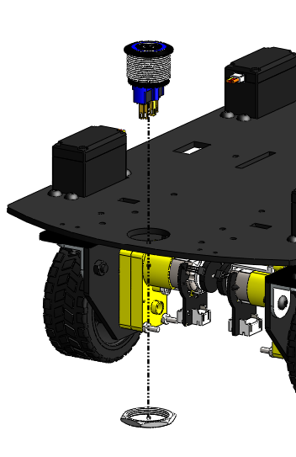
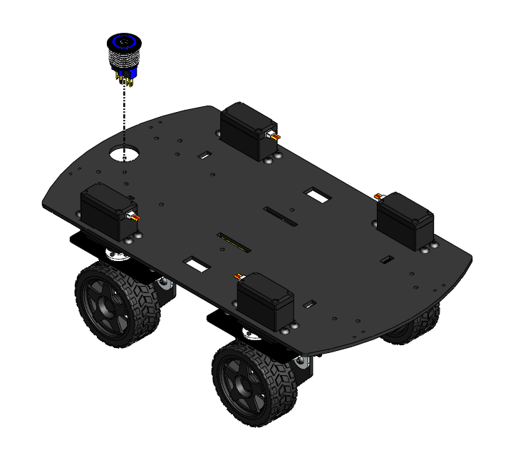
REAR VIEW
THE SWITCH IS INSERTED INTO THE SLOT FROM ABOVE, THEN THE NUT IS TWISTED IN PLACE FROM BELOW

Slide 13
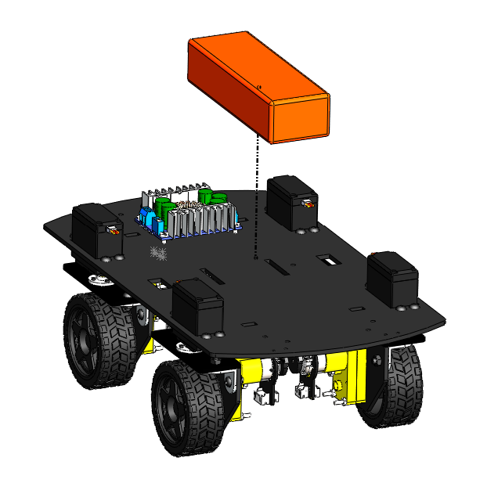
BATTERY STRAP SLOTS
BATTERY STRAP SLOTS

Slide 14
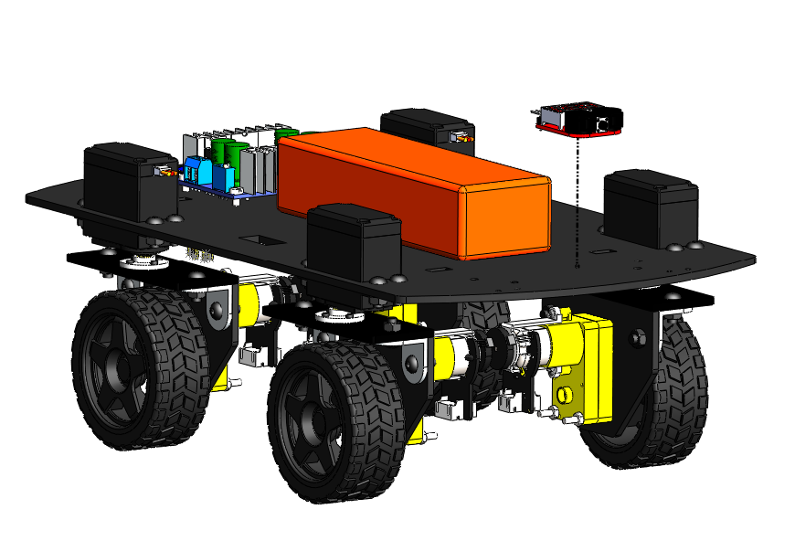
DOUBLE SIDED TAPE

Slide 15
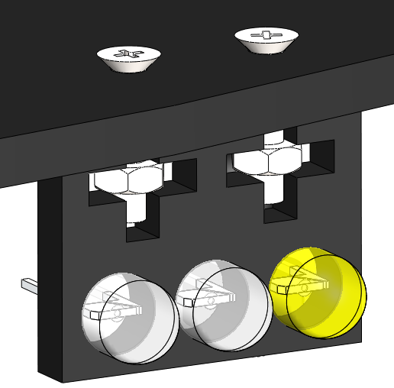
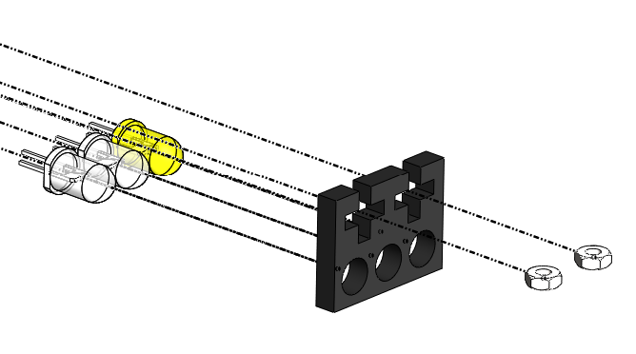
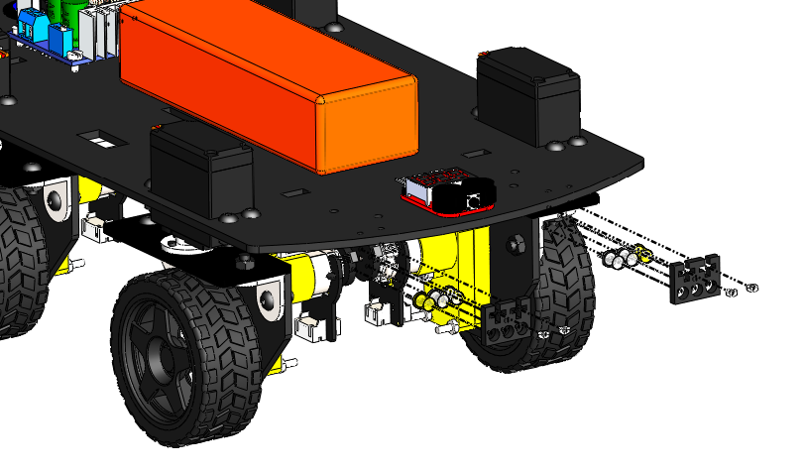
M2 NUT

Slide 16
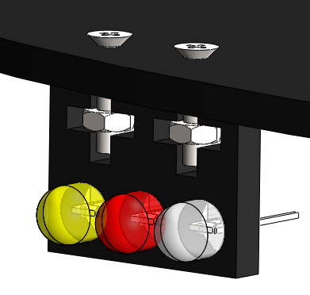
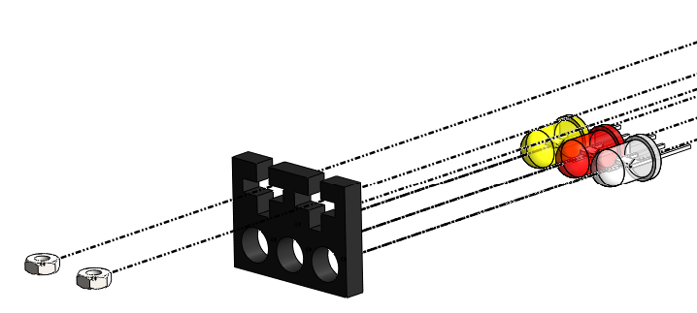
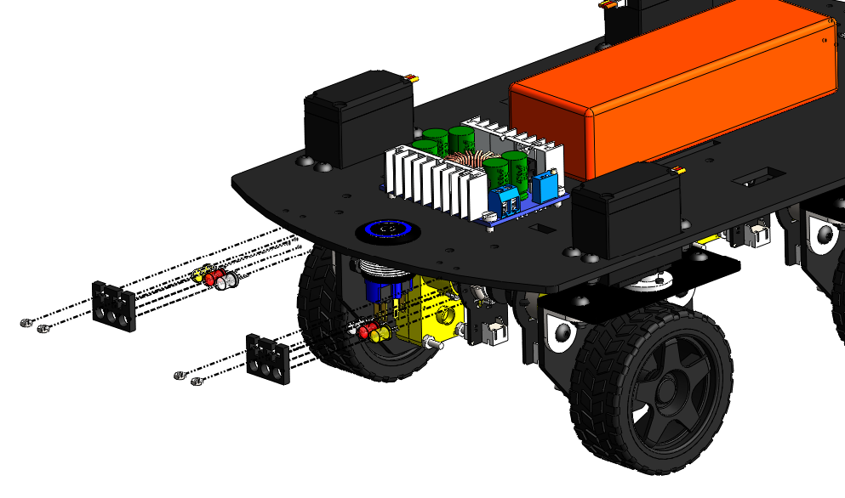
M2 NUT

Slide 17
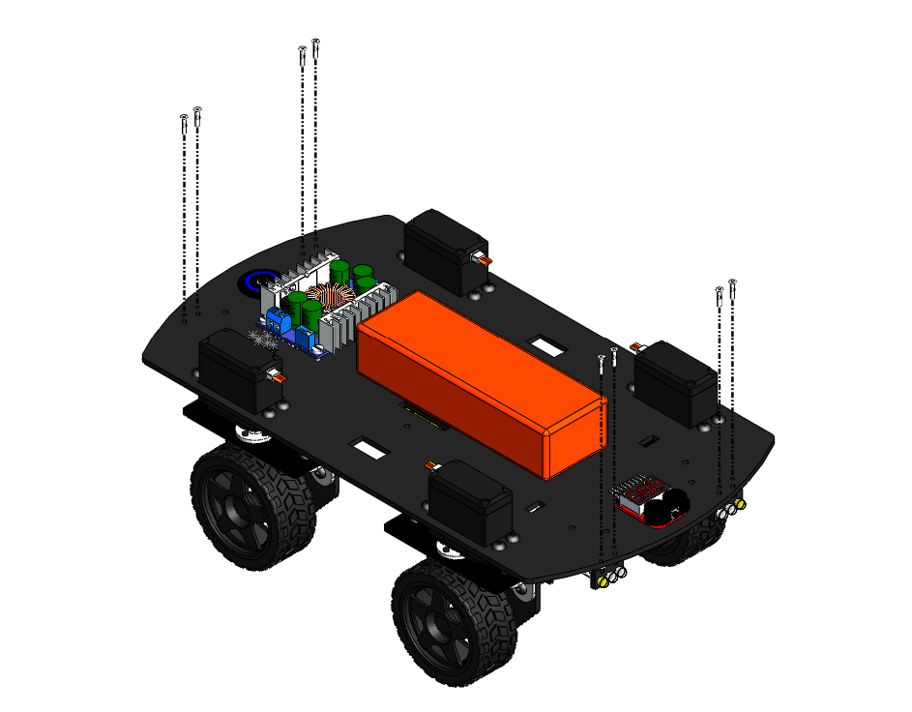
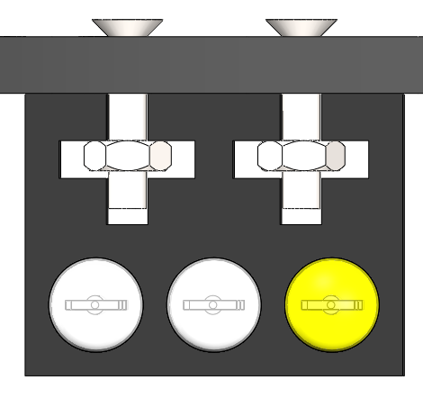
M2 X 10 BOLT

Slide 18
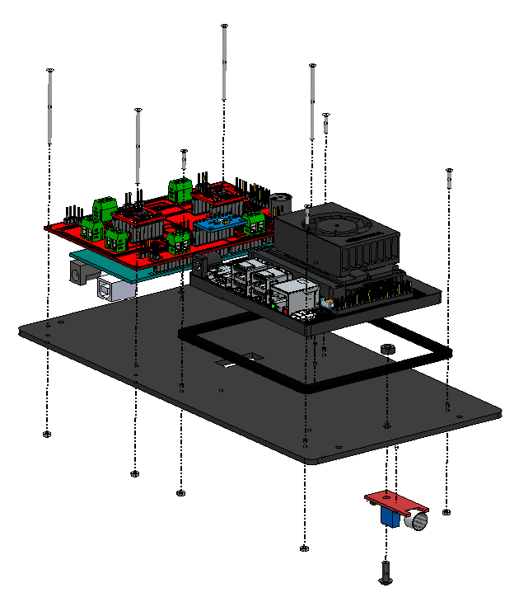
2
1
3

Slide 19
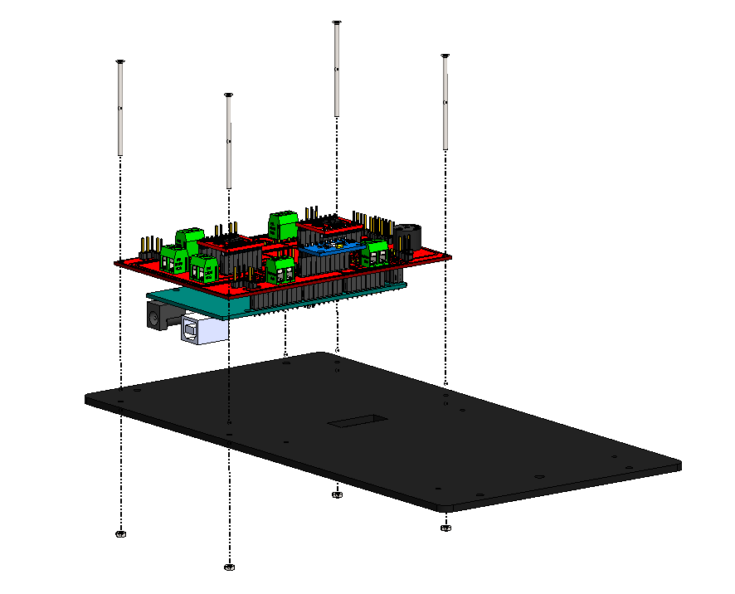
M2 x 25 BOLT
M2 NUT

Slide 20
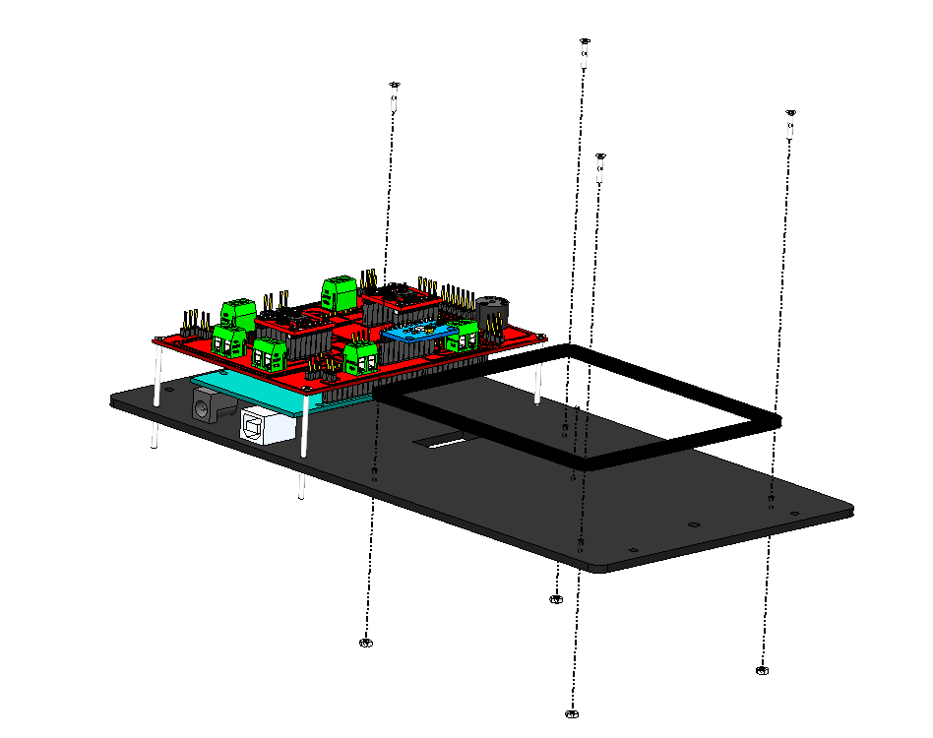
M2 x 10 BOLT
M2 NUT

Slide 21
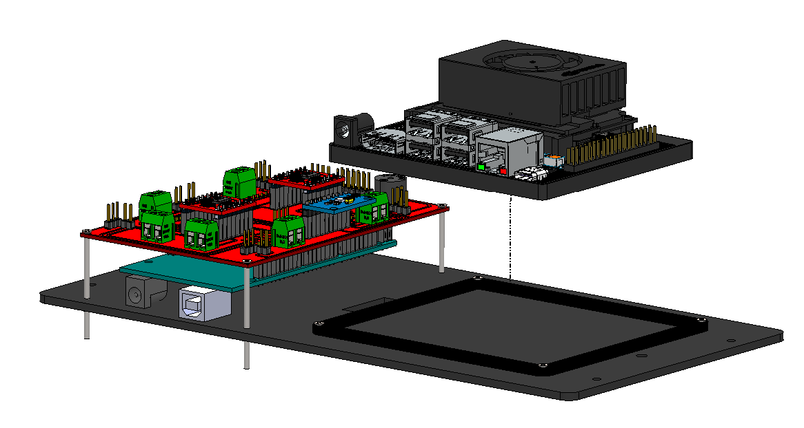

Slide 22
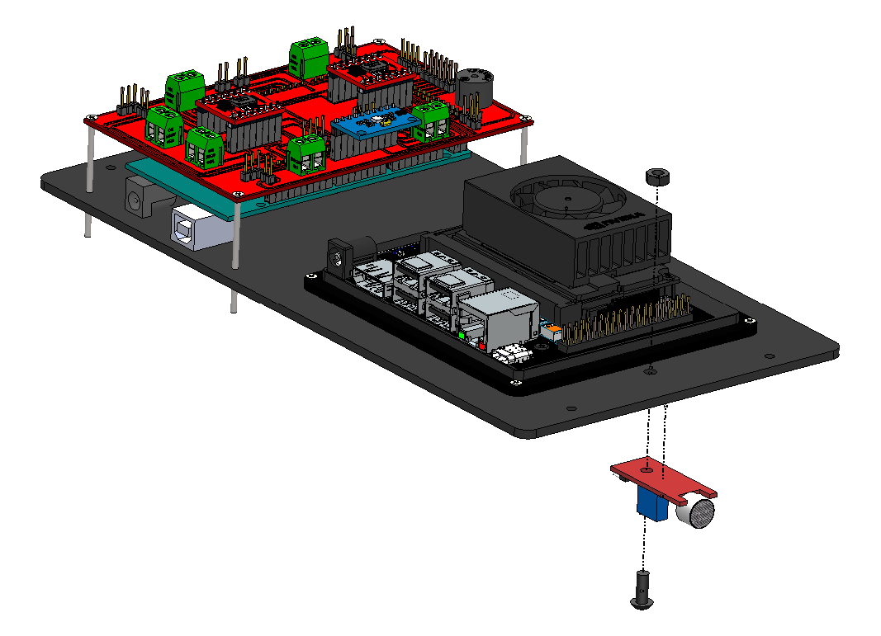
M4 NUT
M4 x 10 BOLT

Slide 23
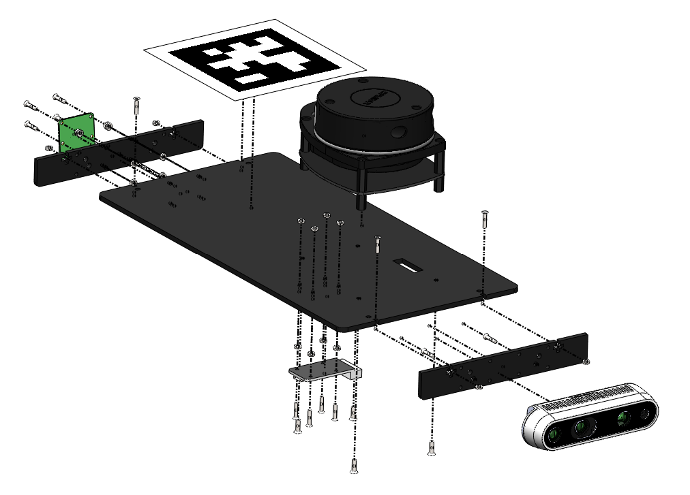
5
2
4
3
1

Slide 24
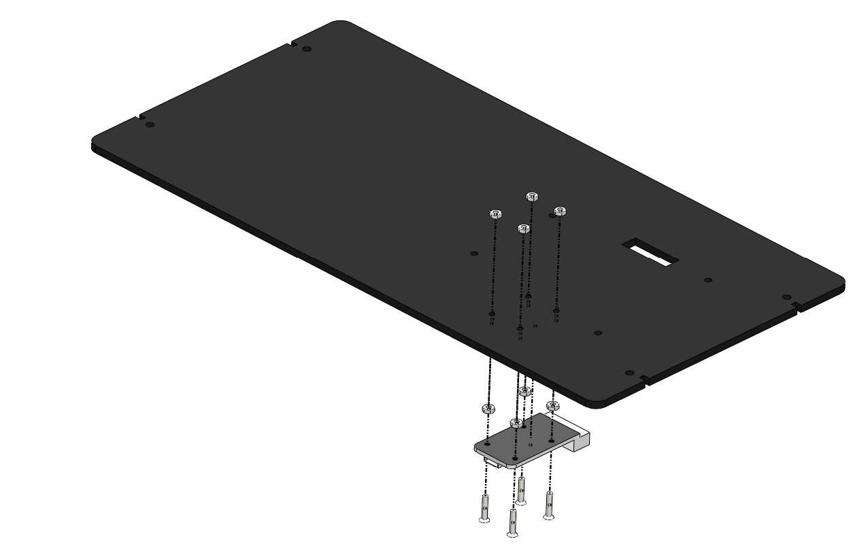
M2 NUT
M2 NUT AS A SPACER
M2 x 10 BOLT

Slide 25
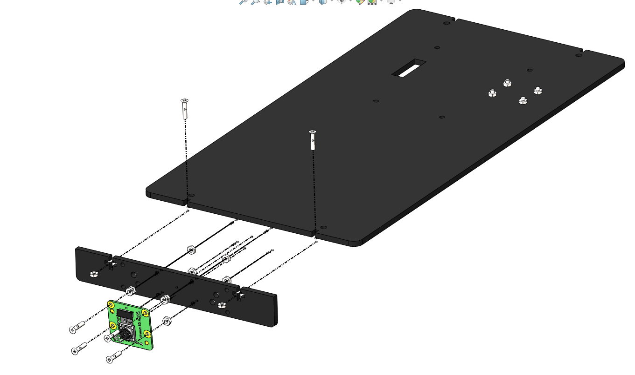
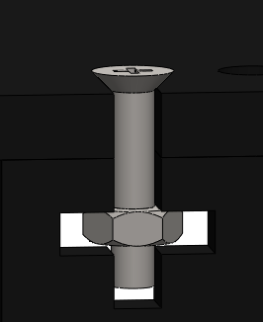
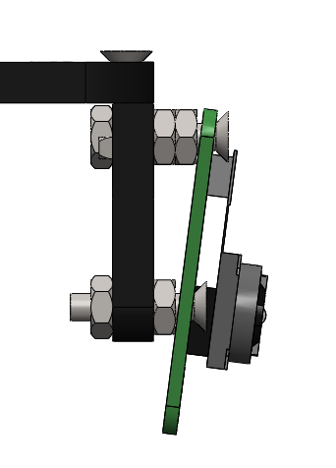
M2 x 10 BOLT
2 NUTS ON TOP
M2 NUT
M2 NUT
M2 x 10 BOLT
SIDE VIEW

Slide 26
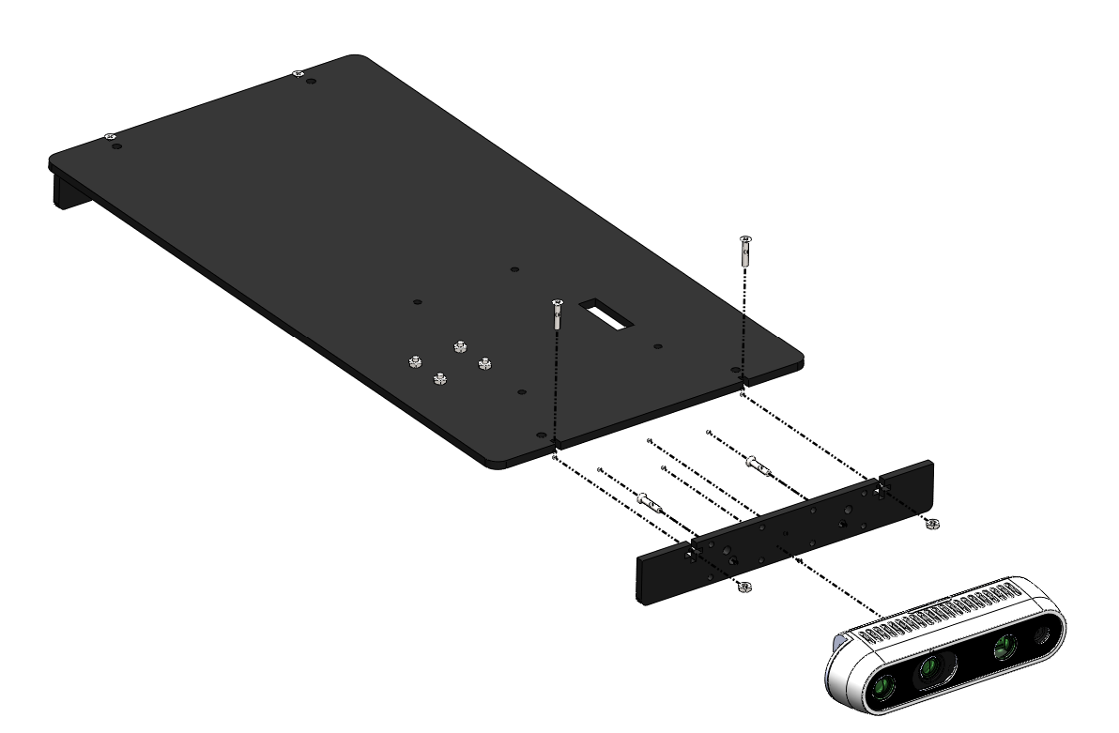
M3 x 8 BOLT
M3 x 6 BOLT
M2 NUT

Slide 27
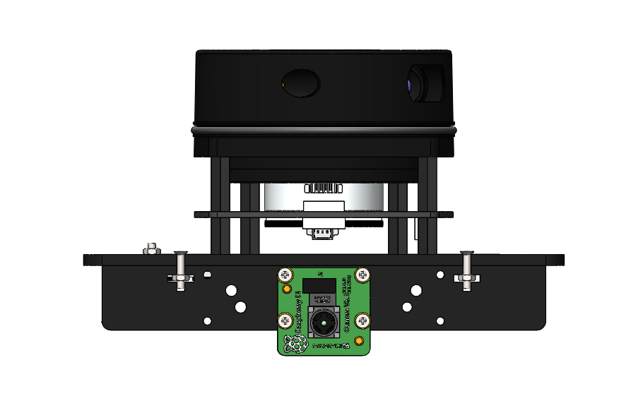
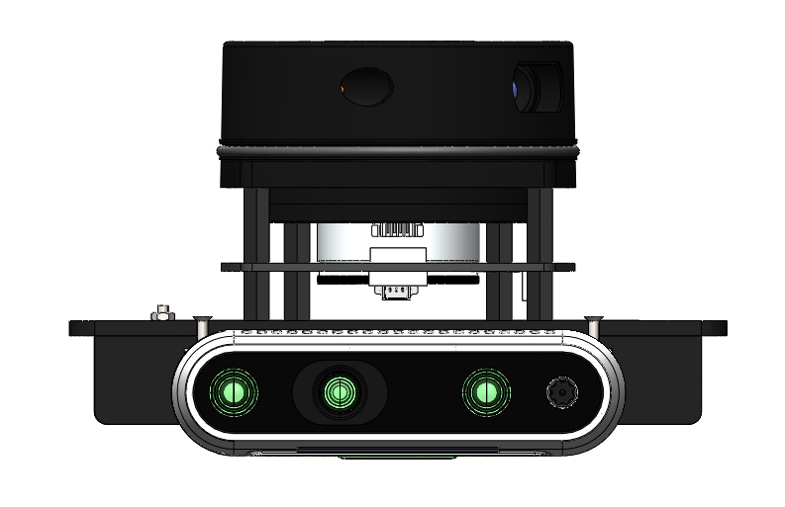
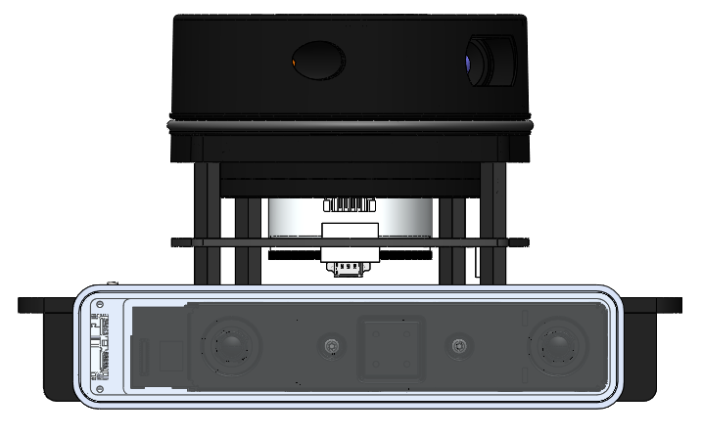

Slide 28

PI CAM v2.1 | INTEL D435i | INTEL T265

Slide 29
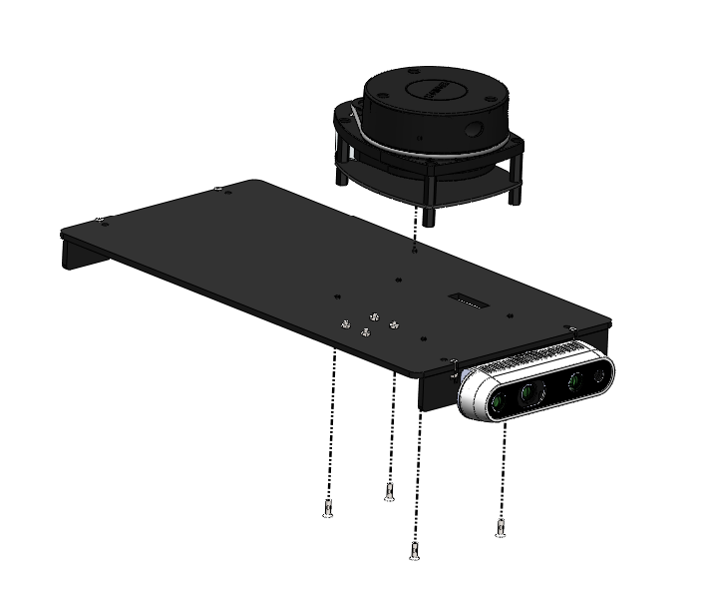
M2.5 x 8 BOLT

Slide 30
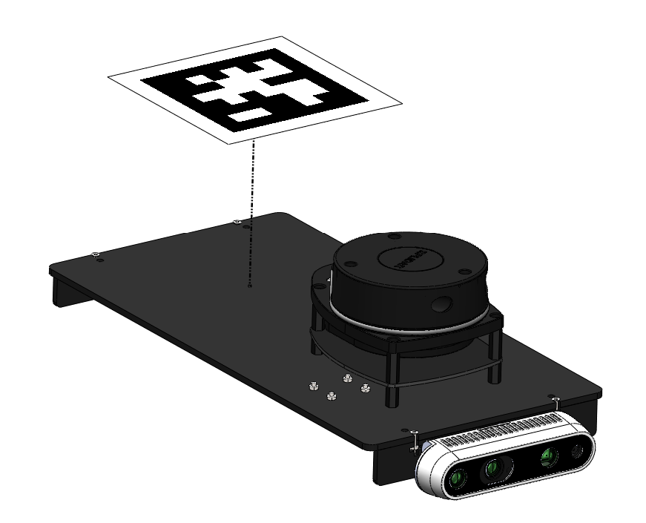
APRIL TAG IS PASTED ON

Slide 31
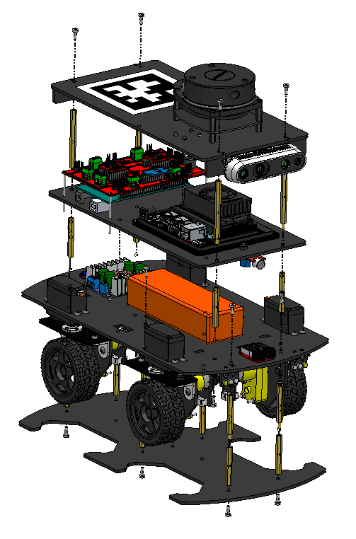
6
4
5
3
1
2

Slide 32
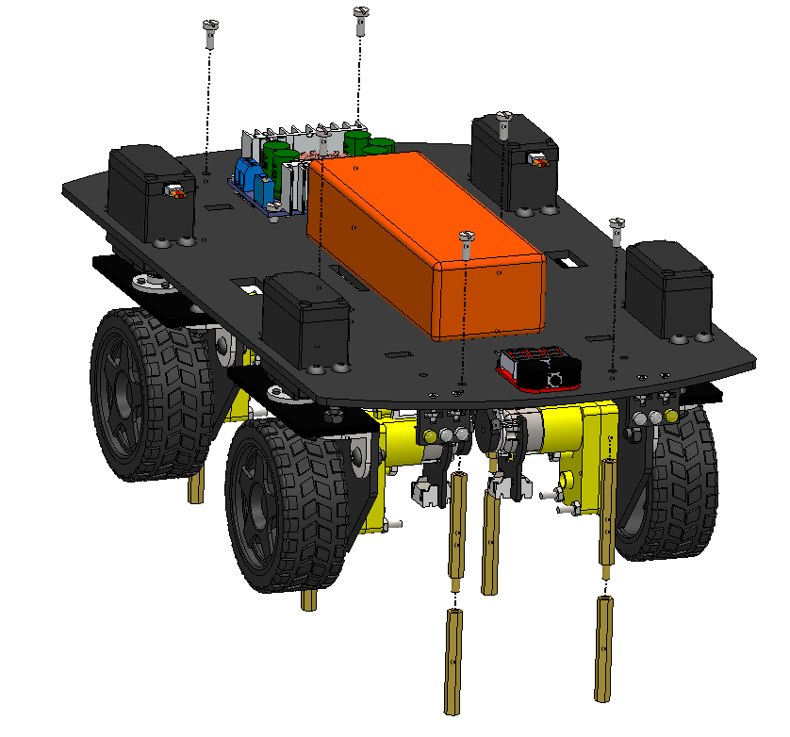
M3 X 8 BOLT
M3 x 40 M-F STANDOFF
MALE SIDE
M3 x 40 F-F STANDOFF

Slide 33
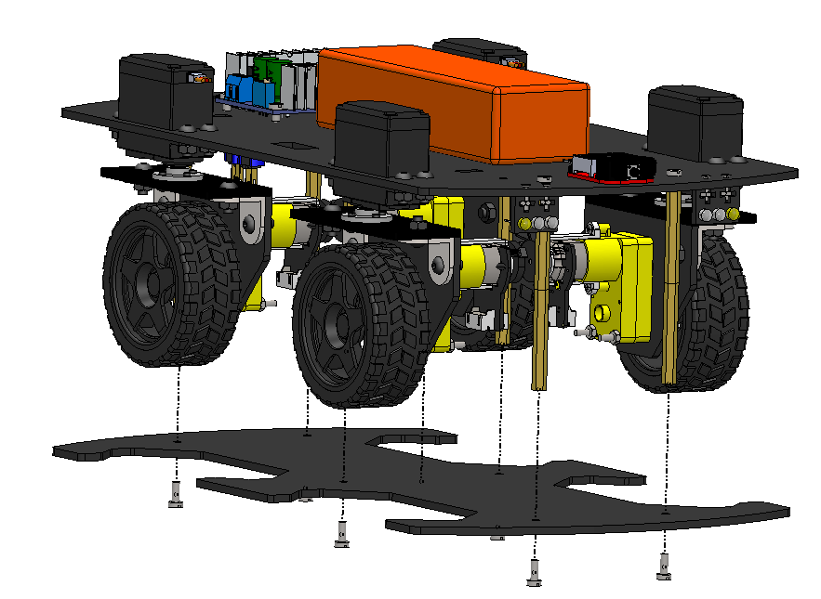
M3 x 40 M-F STANDOFF
+
M3 x 40 F-F STANDOFF
STACK
M3 X 8 BOLT

Slide 34
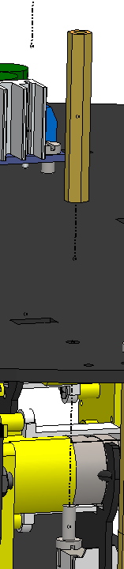
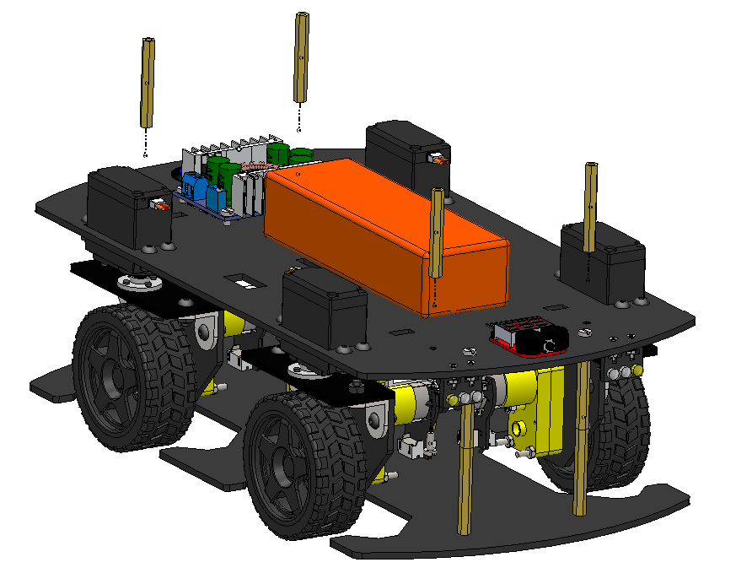
M3 x 40 F-F STANDOFF
M3 X 8 BOLT

Slide 35
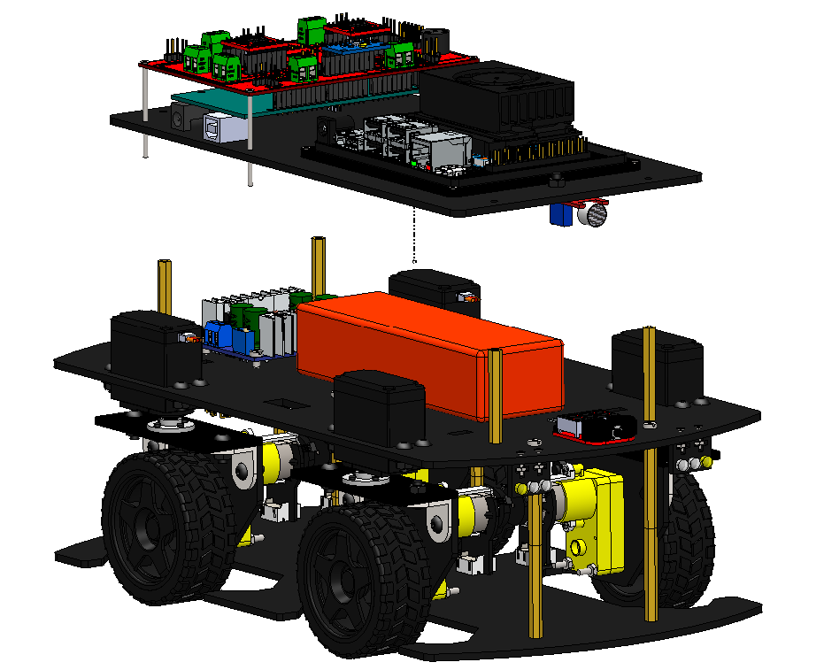

Slide 36

M3 x 60 M-F STANDOFF
FEMALE SIDE
MALE SIDE

Slide 37

M3 X 8 BOLT

